Slide 1

Different types of LLMs: Based on Response

Slide 2

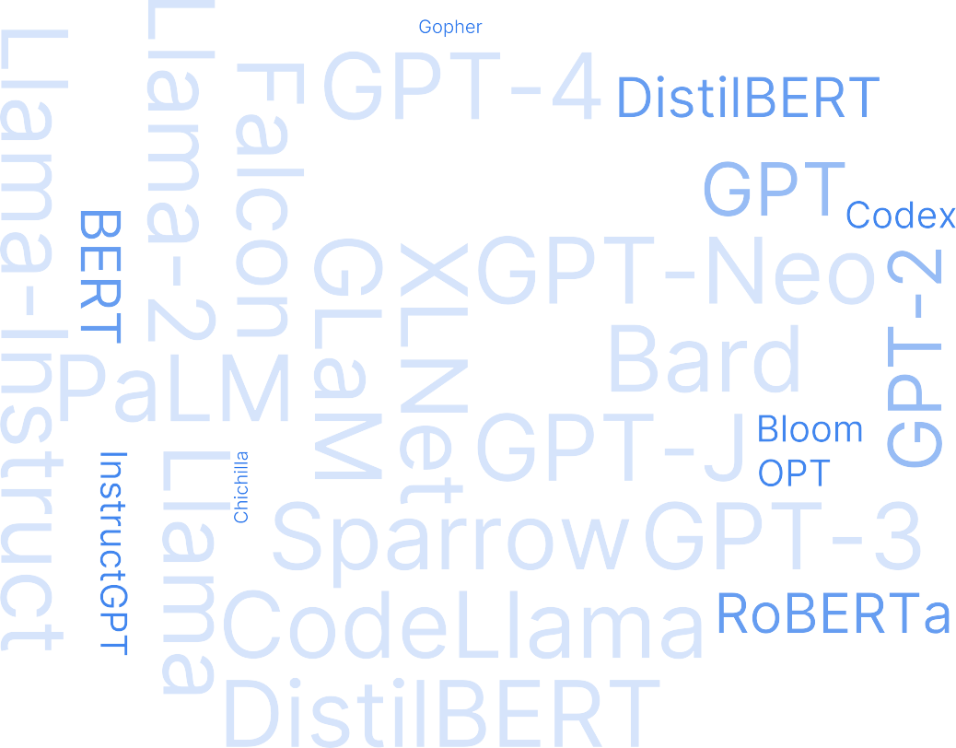



Slide 3
Different types of LLMs
Based on Response
Based on Model Architecture

Slide 4
Different types of LLMs
Based on Response
Based on Model Architecture

Slide 5
Different types of LLMs
Based on Response
Based on Model Architecture
1. Continuing the text LLMs

Slide 6
Different types of LLMs
Based on Response
Based on Model Architecture
Continuing the text LLMs
Instruction Following LLMs

Slide 7
John is a professor at ________
prestigious Ivy League university, where he teaches courses in computer science and artificial intelligence. He is widely recognized for his contributions to the field of machine learning and has published numerous research papers. In addition to his academic role, John also actively collaborates with industry leaders on cutting-edge technology projects.
Continuing the text LLMs
LLMs excel at completing the text

Slide 8
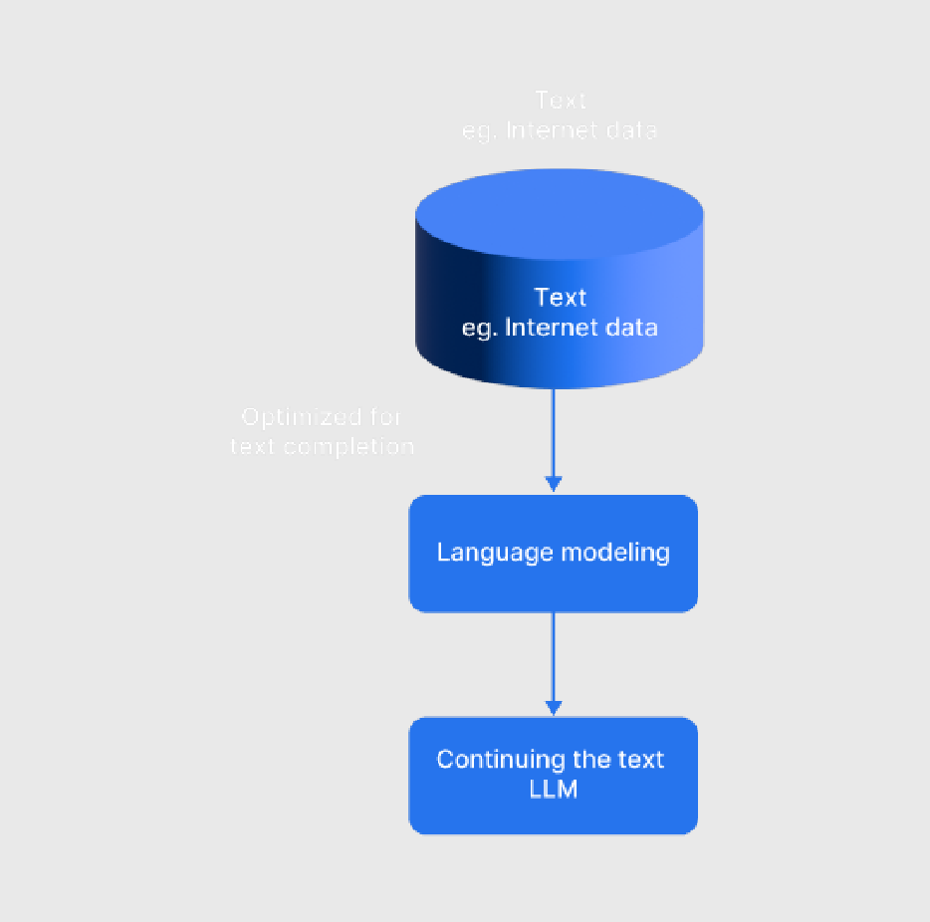
Training Objective
Predict the next word in the text

Slide 9
Hope you are
Example:
Hope you are doing
LLM
well

Slide 10
Completion Use Cases
Classification
Translation
Completion tasks
Summarization
Question Answering

Slide 11

Continuing the text LLMs: Use Cases
How are you in hindi is
kaise ho

Slide 12






Continuing the text LLMs: Examples

Slide 13
Different types of LLMs
Based on Response
Based on Model Architecture
Continuing the text LLMs
Instruction following LLMs

Slide 14

Instruction Following LLMs
Good at responding back to the user inputs/query.

Slide 15
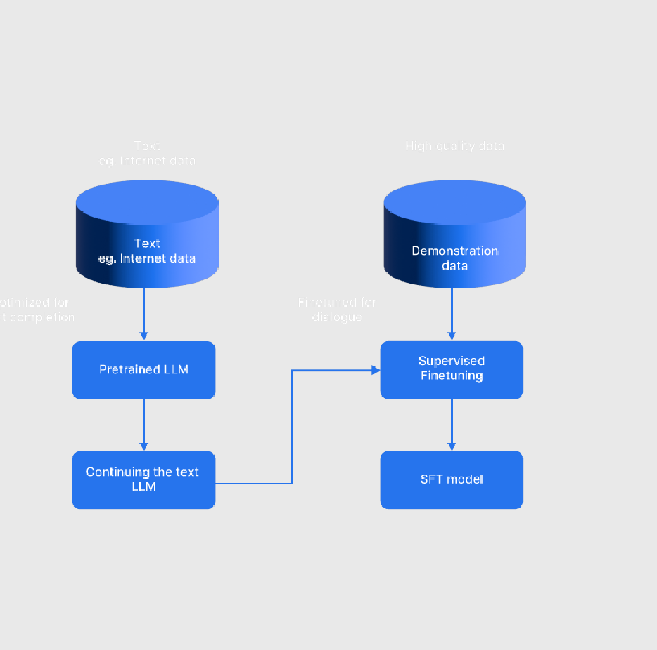
Instruction Following LLMs: Training Objective
Finetune the continuing the text LLM on conversations

Slide 16

Instruction Following LLMs: Training Objective
At this stage the model may be unsafe and may generate harmful responses.
How can I attack the system?
SFT Model
Drive by attack, Password attack, Malware attack

Slide 17

Instruction Following LLMs: TrainingObjective
Reinforcement Learning from Human Feedback RHLF
Improves the safety of the model.

Slide 18
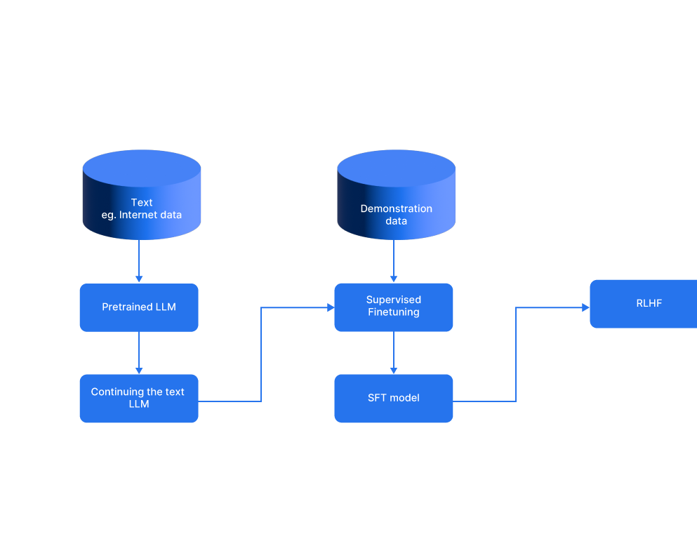
Instruction Following LLMs: Training Objective
SFT model along with RLHF improves the model safety

Slide 19




Examples of Instruction Following LLMs

Slide 20
Different types of LLMs
Based on Response
Based on Model Architecture
Continuing the text LLMs
Instruction following LLMs

Slide 21
Thank You

